Slide 1
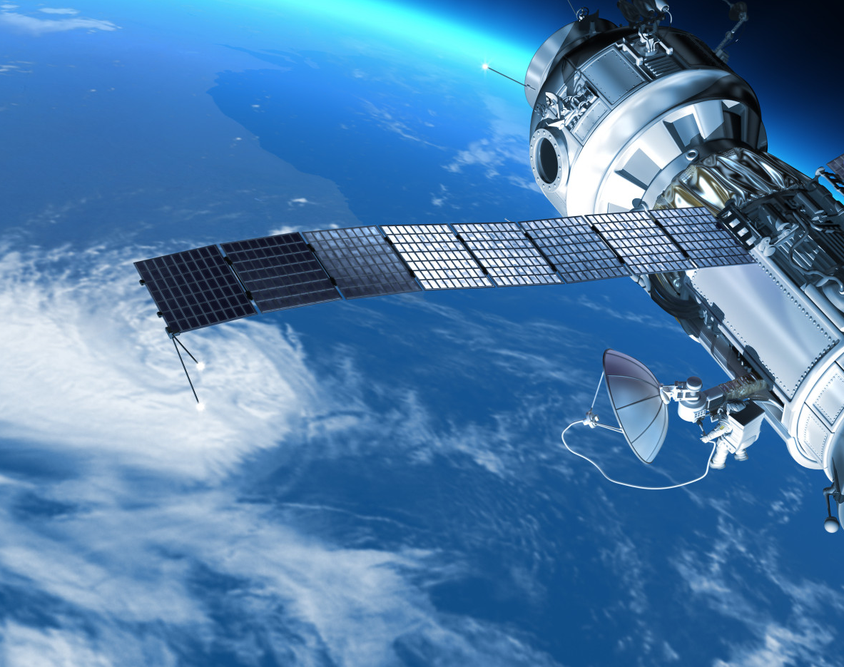
URBAN GROWTH PREDICTION
Sougandh Krishna K S (IMT2020120)
Heet Vasani (IMT2020088)
Prince Butani (MS2022006)
Satvik Verma (IMT2020046
This Photo by Unknown author is licensed under CC BY-NC-ND.

Slide 2
Literature Review : Conclusions
From the papers that we have gone through, we can concluded that CA model and Molusce Plugin which implements ANN best suits our requirements.
CELLULAR AUTOMATA
The CA model is used to predict spatial patterns of land-use changes by setting required thresholds.
ANN USING MOLUSCE
The MOLUSCE plugin is an open-source plugin for QGIS 2.0 and above, and is used to simulate land use/cover changes by incorporating Artificial Neural Networks (ANN) algorithm.

Slide 3
Problem Statement
Bangalore is one of the most dense cities in India and the IT capital of our country. This leads to the inflow of skilled and unskilled labour from around the country, leading to a high demand in housing projects and a rapid urban development in the outskirts of the city. Recent rainfall has shown that some areas in the city are prone to floods because of poor urban planning and development on land previously occupied by lakes and water bodies.

Slide 4
Objective
This project aims to predict the urban growth of Bangalore City using the Molusce Model of QGIS and CA model to help authorities plan better.

Slide 5
The Dataset
LULC DATA from Landsat (2017 to 2022)
Population Density (2017 to 2021)
Digital Elevation Model (DEM)
Slope
Proximity with roads (Road Network)

Slide 6
Models
Cellular Automata
ANN using Molusce Plugin

Slide 7
CA Prediction Accuracy with 1-year gap
LULC | LULC Year Used For Prediction | Accuracy | KAPPA
2019 | 2018 | 87.2428 | 0.8121
2020 | 2019 | 87.2346 | 0.8102
2021 | 2020 | 89.0800 | 0.8339
2022 | 2021 | 85.5751 | 0.7875

Slide 8
CA Prediction Accuracy with 2-year gap
LULC | LULC Year Used For Prediction | Accuracy | KAPPA
2019 | 2017 | 76.3676 | 0.6673
2020 | 2018 | 85.0453 | 0.7727
2021 | 2019 | 85.7605 | 0.7845
2022 | 2020 | 88.4919 | 0.8313

Slide 9
Molusce Accuracy with 2-year gap
LULC | LULC Year Used For Prediction | Accuracy | KAPPA
2019 | 2017,2015 | 71.0681 | 0.6047
2020 | 2018,2016 | 74.4888 | 0.6243
2021 | 2019,2017 | 85.2186 | 0.7737
2022 | 2020,2018 | 82.5795 | 0.7455

Slide 10
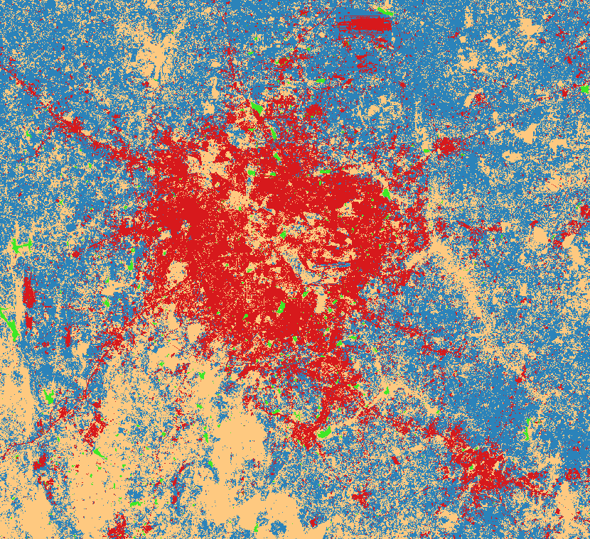
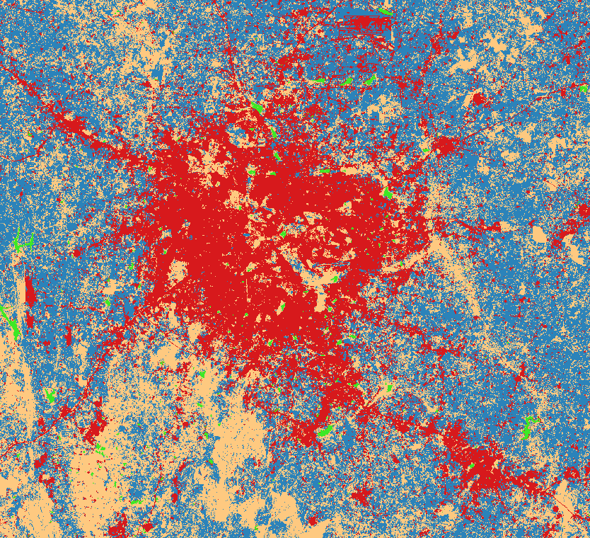
Predictions (CA)
1 Year Gap
2021 LULC
Prediction

Slide 11
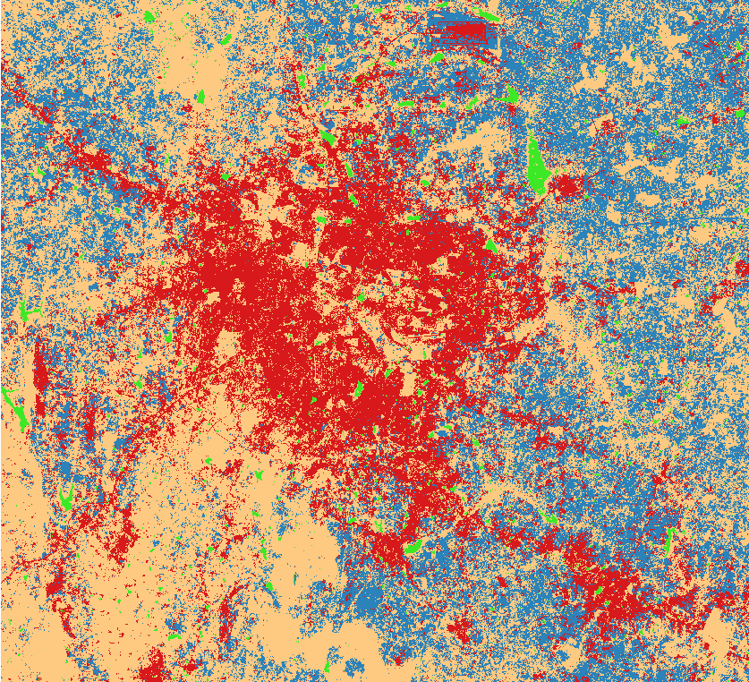
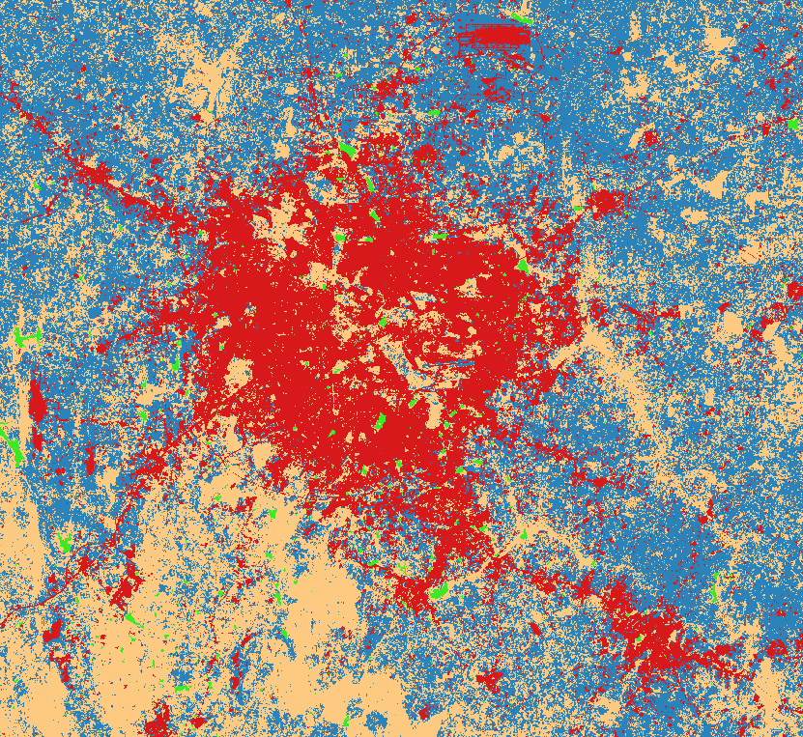
Predictions (CA)
1 Year Gap
2022 LULC
Prediction

Slide 12
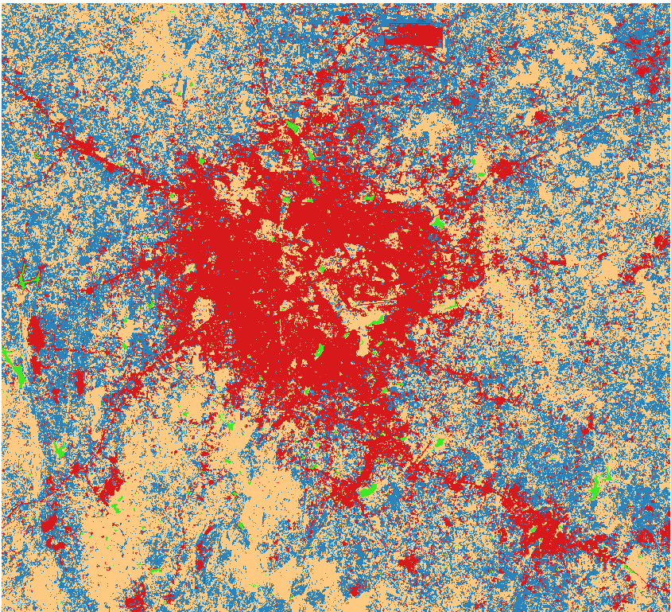
Predictions (CA)
2 Year Gap
2021 LULC
Prediction

Slide 13

Predictions (CA)
2 Year Gap
2022 LULC
Prediction

Slide 14
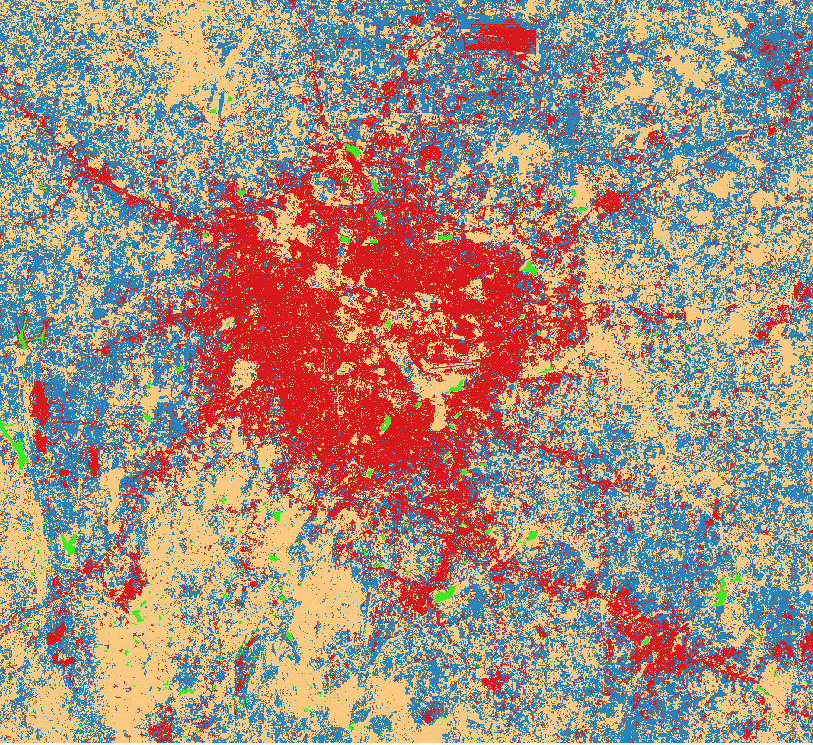
Predictions (Molusce)
2021 LULC
Prediction

Slide 15

Predictions (Molusce)
2022 LULC
Prediction

Slide 16
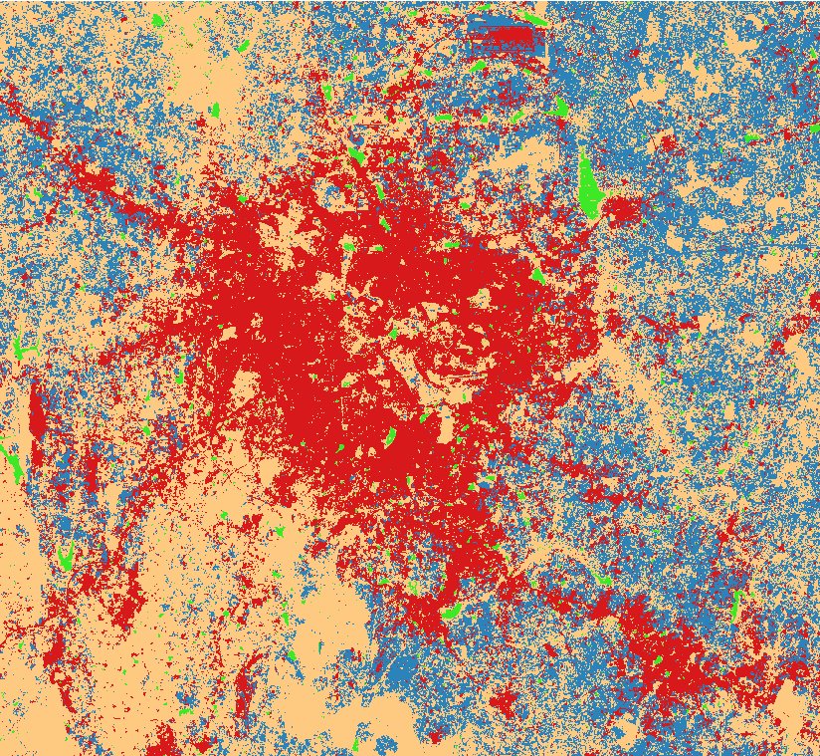
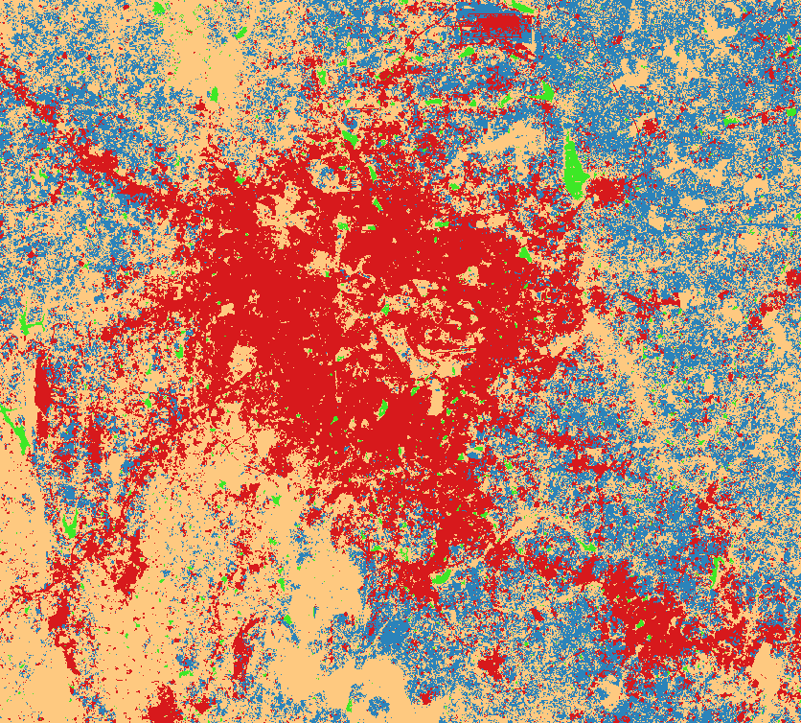
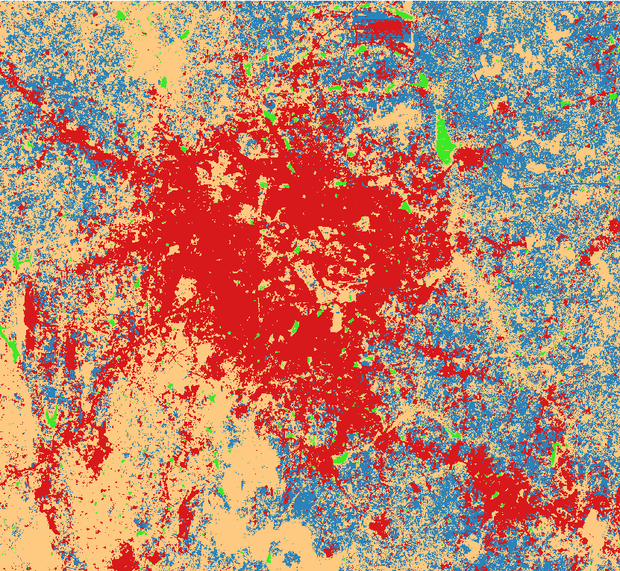
Future Predictions (CA)
2023
2024
2025

Slide 17
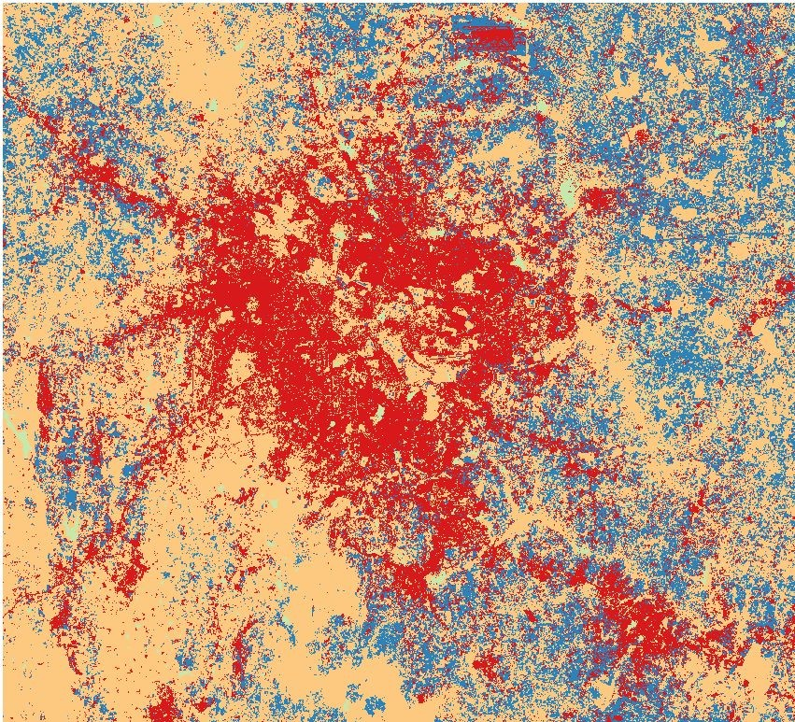
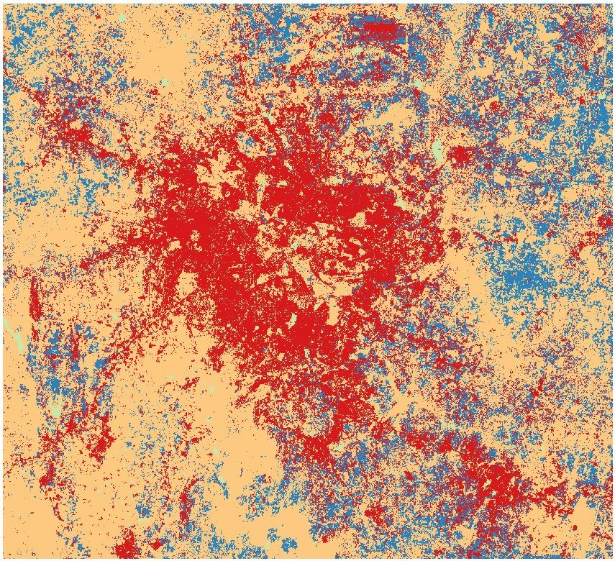
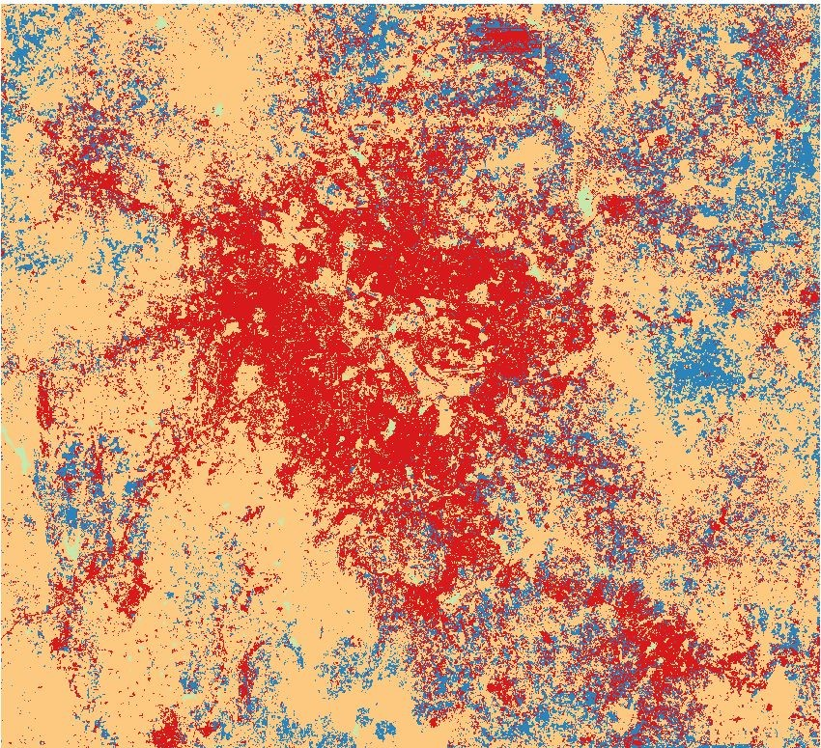
Future Predictions (Molusce)
2025
2035
2050

Slide 18
Conclusions
In this project we have implemented CA and molusce models with the prediction for different years.
The results for both the models shows us that the accuracy and kappa values increase with time, i.e. from 2019 to 2022.
It can be inferred from the results that CA model has better prediction compared to molusce model.
One of the main reasons molusce plugin is not available in the new versions of QGIS is that better models like CA models have proved to be more useful that the older plugins.
The changes in the urban build up shows us that the environmental effects of climate change has resulted in a decrease in water bodies and vegetation while an increase in the urban land use.

